Slide 1
Chapter 3Website
By:Umer farooq

Slide 2
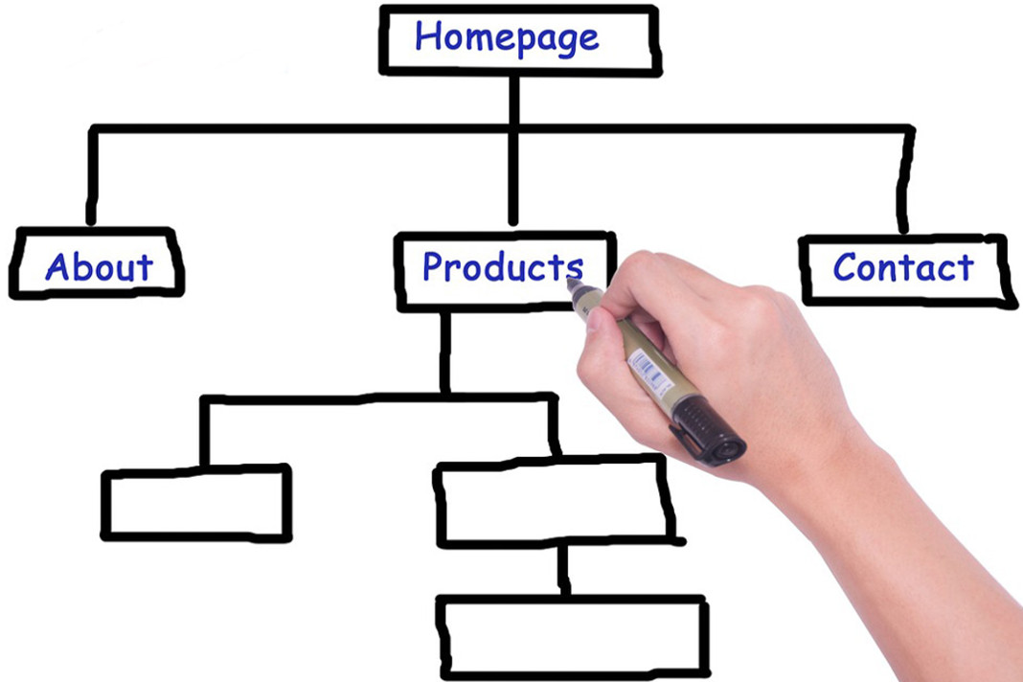
Structure of website
Google search till level 4
Good structure help for SEO

Slide 3
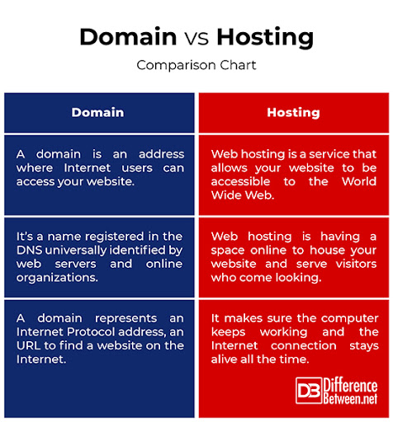
Difference between Domain and Hosting

Slide 4
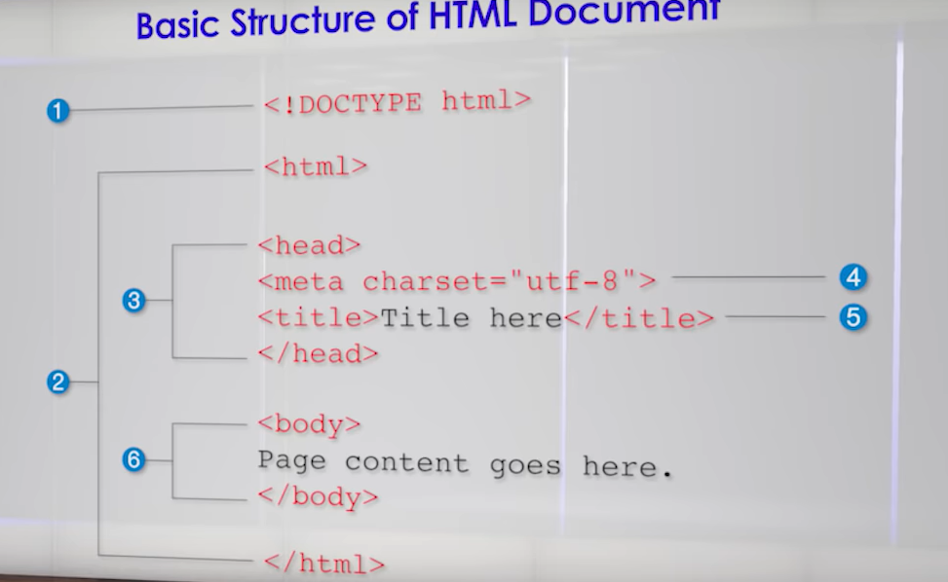
What is HTML? Why is it Important?
HTML is a markup language
Used to create webpage
Standard of web

Slide 5
Home Page - The most Important Page
All information of the website
Complete information of website
Multipages website recommended
Single pages website partially not recommended

